Slide 1
Peg solitaire
Puzzle game - Coded in c++

Slide 2
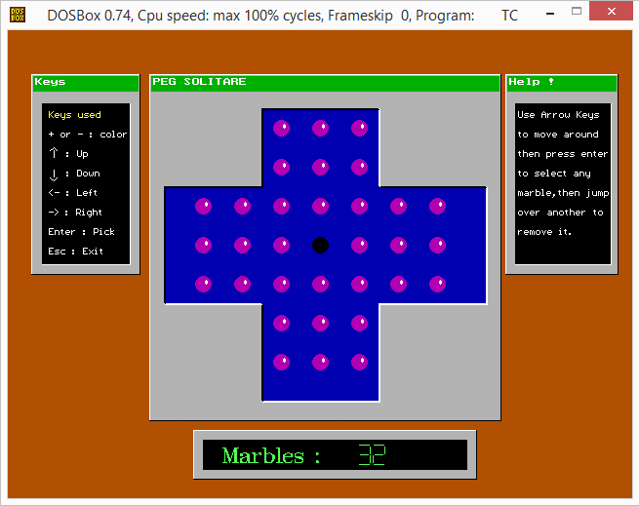

Slide 3
Peg solitaire
Peg solitaire (or Solo Noble) is a board game for one player involving movement of pegs on a board with holes. Some sets use marbles in a board with indentations. The game is known simply as Solitaire in the United Kingdom where the card games are called Patience. It is also referred to as Brainvita (especially in India).
The objective of the game is to empty the board and leave only one peg in the central square.

Slide 4
Concepts used
Looping constraints
Conditional statements
Functions
Graphics
BIOS interrupt calls

Slide 5
HEADERS files USED
Graphics.h
This interface provides access to simple graphics functions.
Stdlib.h
Used for exit() function.
Iostream.h
This is used for basic input / output operations.
Conio.h
This header is used for console input / output operations like kbhit() and getch().
Dos.h
This header is containing functions for handling interrupts, producing sound and delay.
Time.h
Contains functions to manipulate date and time.
Bios.h
This header is used to make use of bioskey command.

Slide 6
User defined functions
Function to open graph
void Graph();
Function to create marbles
void Marble(int x, int y, int col);
Function to create background
void Background();
Function to draw board
void DrawBoard();
Function to get board
int GetBoard(int X, int Y);
Function to set board
void SetBoard(int X, int Y, int element);

Slide 7
User defined functions
Function for intro screen
void Intro();
Function for creating shadows
void winp(int sx, int sy, int ex, int ey, int state);
Function for creating dialog boxes with title bar
void win(char *text, int sx, int sy, int ex, int ey, int ck);
Function to draw border
void DrawBorder(int x, int y);
Function to generate LCD style numbers
void LCD(int left, int top, int NUM);
void Lcd(int x, int y, int n);

Slide 8
User defined functions
Function to perform blink action
void Blink(int x, int y, int c);
Function which handles all functions and perform moves
void Init();
Function to get current coordinates
int GetXY(int X, int Y);
Function to check for valid moves
int check();
Function to make a move
int MakeMove(int X, int Y);
Function to display finish page
int finish();

Slide 9
Built in Functions
Kbhit()
Used to determine if key has been pressed or not.
Clock()
Returns the number of clock ticks elapsed since program was launched.
Graphresult()
Returns error code for last graphics operations.
Grapherrormsg()
Displays error message corresponding to error code.
Imagesize(x1, y1, x2, y2)
Returns bytes required to store image in memory.

Slide 10
Built in Functions
Initgraph(gd, gm, path)
To initialize the graph.
Closegraph()
To close the currently open graph.
Setfillstyle(style, color)
Set style and color according to the arguments.
Setcolor(color)
Set the color.
Fillellipse(x, y, r1, r2)
Used to draw solid ellipse at (x, y) having major and minor axes as r1 and r2 respectively.

Slide 11
Built in Functions
Bar(x1, y1, x2, y2)
Used to draw bar with top left coordinates (x1, y1) and bottom right coordinates (x2, y2).
Settextstyle(font, direction, size)
Used to set the text style to respective font and size in horizontal or vertical direction.
Outtextxy(x, y, text)
Used to display the given text at (x, y).
Line(x1, y1, x2, y2)
Used to draw a line between coordinates (x1, y1) and (x2, y2).
Setfillpattern(pattern, color)
Used to create user defined pattern of given color.

Slide 12
Built in Functions
Rectangle(x1, y1, x2, y2)
Used to draw rectangle with top left coordinates (x1, y1) and bottom right coordinates (x2, y2).
Setwritemode(mode)
Decides the mode of writing on graph.
COPY_PUT : Overwrites with the line whatever is on the screen.
XOR_PUT : Combines the line with screen.
Sound(frequency)
Produces sound of given frequency.
Delay(millisec)
Produces delay for given milliseconds.
Nosound()
To stop the current sound.

Slide 13
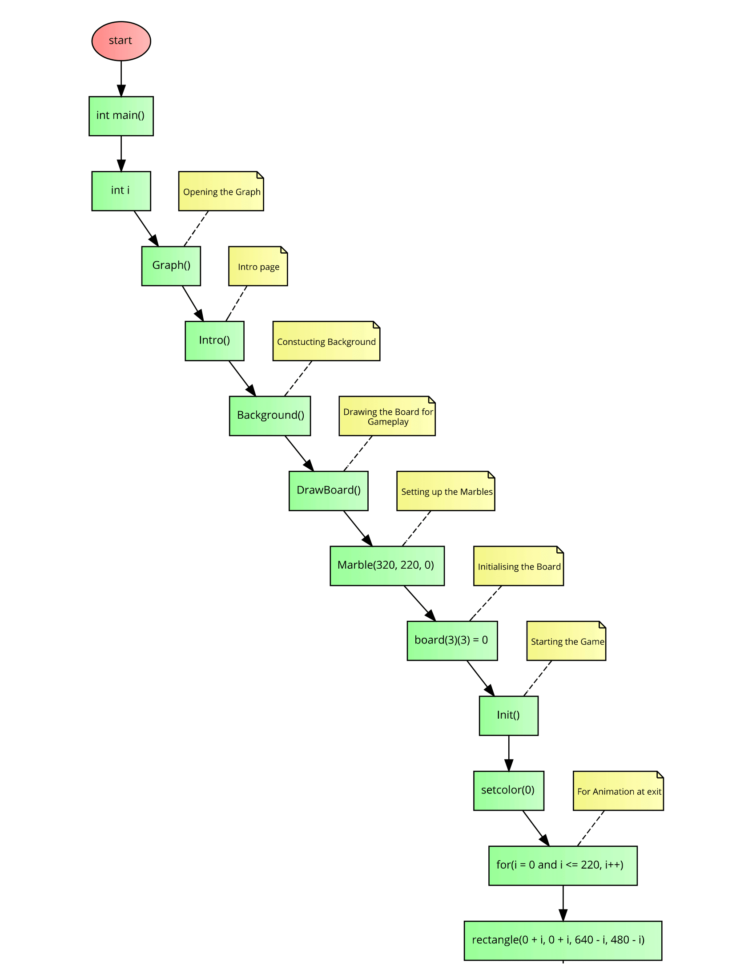
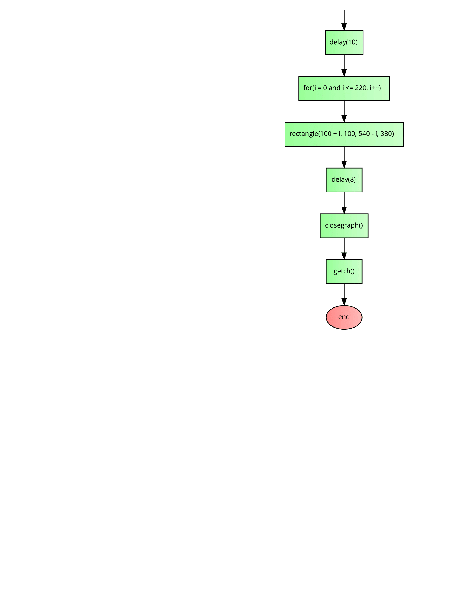

Slide 14
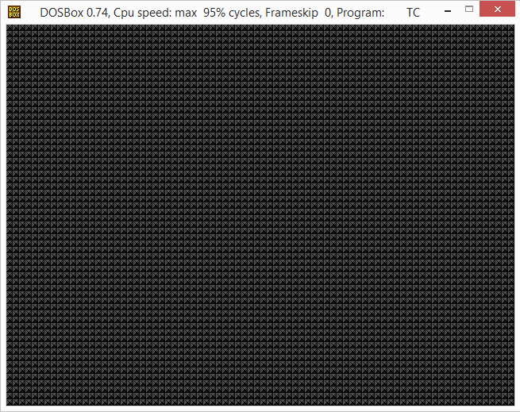
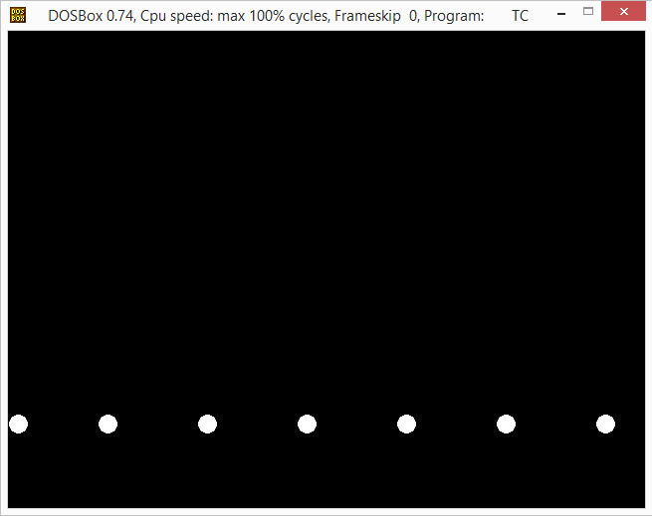
OUTPUTS

Slide 15
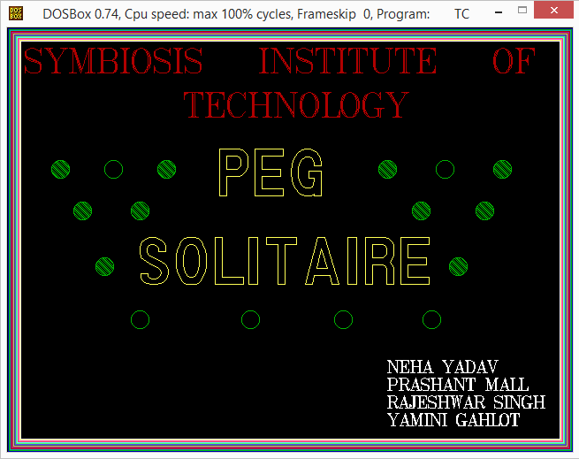
OUTPUTS

Slide 16
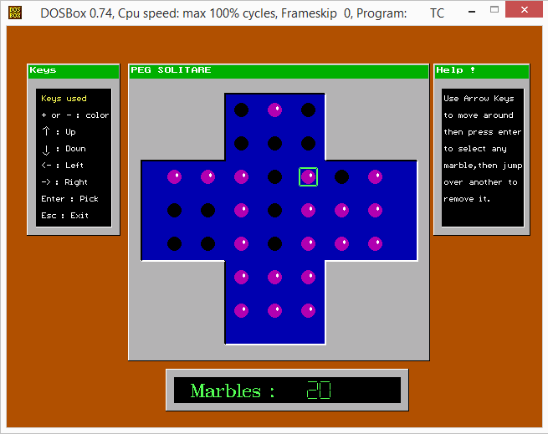
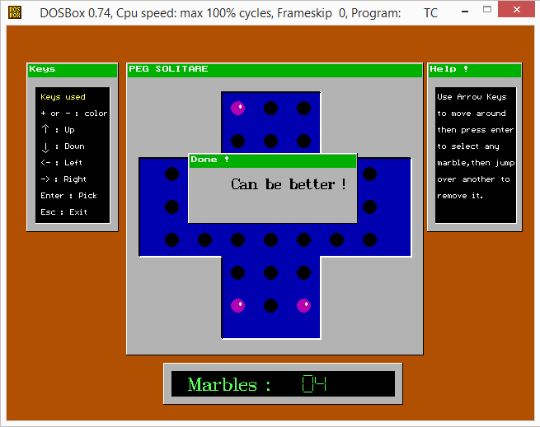
OUTPUTS

Slide 17

OUTPUTS

Slide 18
Thank you

